Slide 1
Hua Li
Created by : Michael Ferger, Michael Chen, Sebastian Mace, Ting Pan, Sze Chang

Slide 2
Agenda
Overview of the Organization
Business Problems/Value of the database
Reports and Forms
Conclusion
Questions

Slide 3
Overview of the operation
Hua Li Floral Business
Company history
Purpose and need
Problems

Slide 4
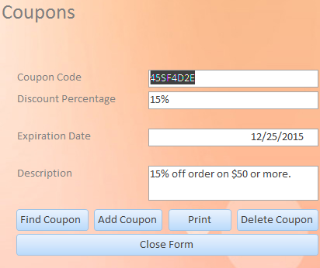
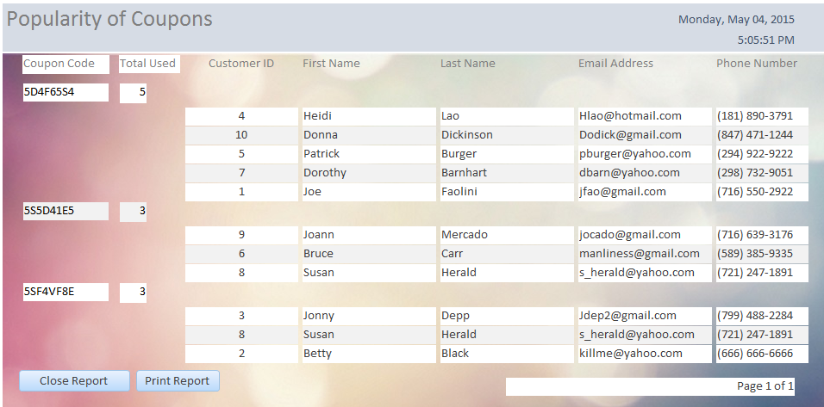
Forms and Reports

Slide 5
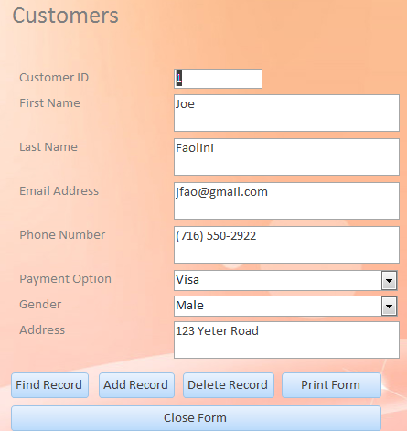
Forms and Reports

Slide 6
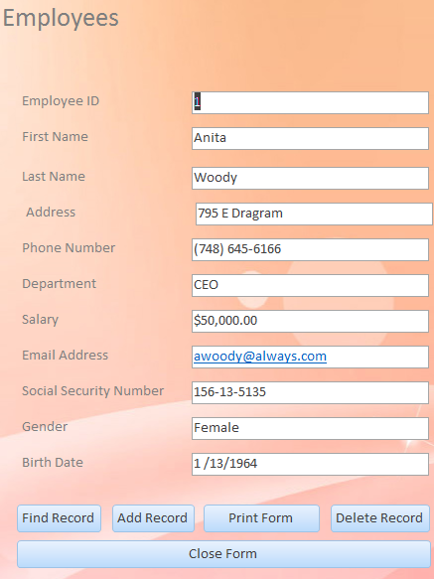
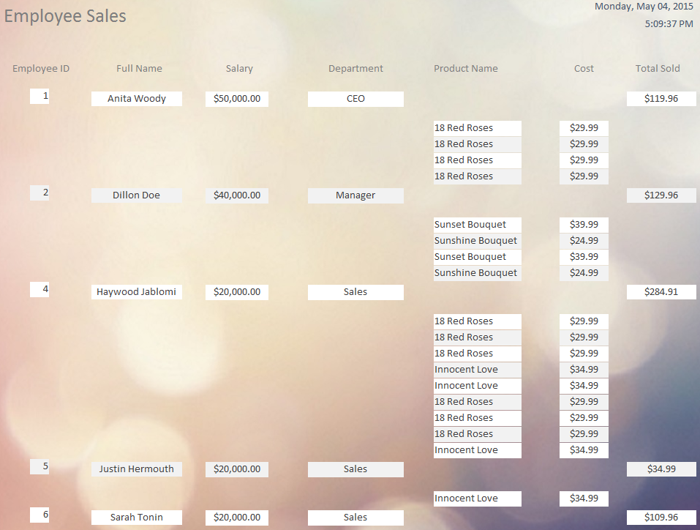
Forms and Reports

Slide 7
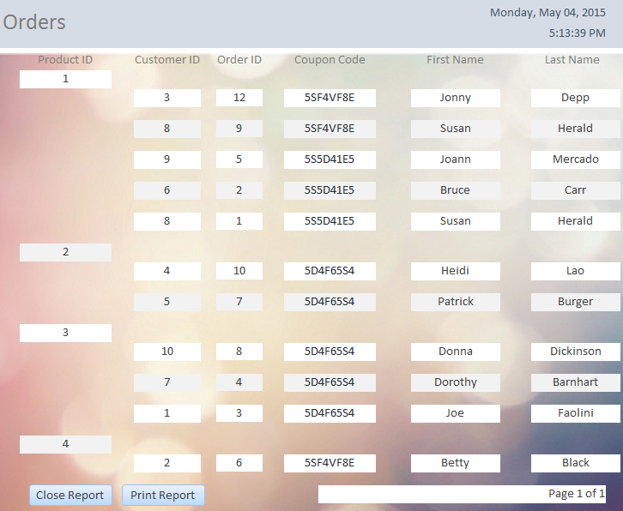
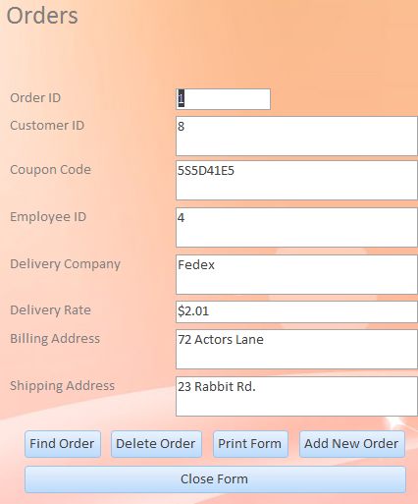
Forms and Reports

Slide 8
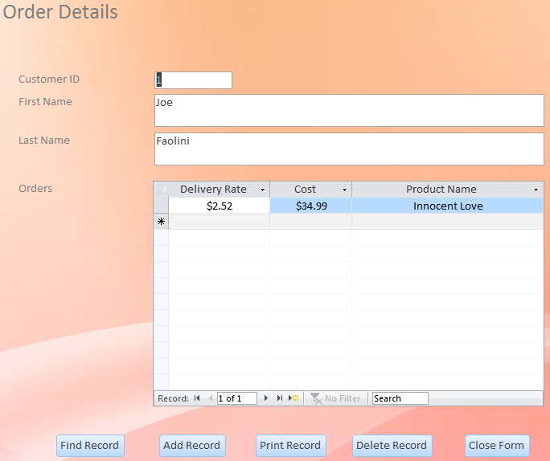
Forms and Reports

Slide 9
Conclusion
Business value
Efficiency
Reduces redundancy

Slide 10
Questions?

